Slide 1





Real Estate Values Based on Introduction of New Professional Sports Teams
Samuel Barton, Owen Meyer, Jordan Heise & Heath Herrington
Notes:
Presentation Frame:
Problem Introduction-1 min
Methodology-1 min
Results
Conclusions
Limitations/Flaws/Access to additional funds
References

Slide 2
Motivation & Problem Statement
Does the addition of a professional sports team increase the home values in a given city?
Group Interests:
Real Estate Work
Real Estate Interest
Current Economy Fluctuations
Sports Interest
Ho: If the establishment of a franchise in a given city is not related to SA index growth, then the establishment of a franchise in a given city will show no improved SA index growth relative to the United States SA Index
Ha: If the establishment of a franchise in a given city is related to SA index growth, then the establishment of a franchise in a given city will show an improved SA index growth relative to the United States SA Index

Slide 3
Questions
Data
What restrictions should we place on our analysis?
Team relocations were restricted to relocations between 1975 and 2020
Teams were restricted to only NFL, MLB, NBA and NHL teams in the US
Does this help to explain the overall benefit of having a sports franchise in a city given the cost?
To value homes: Freddie Mac API
Long term data
Many US cities
SA Index (Used to value home prices in each city and the USA)
An index that provides a seasonally-adjusted measure of typical price inflation for houses within the United States (source: Federal Home Loan and Mortgage Corporation).

Slide 4
Data Cleanup and Exploration
Cleanup
Hard-coding FMAC city strings to merge FMAC Index tables with our cities of interest
Remove duplicate cities as we only need one graph per city
Merge city and country data only where city data exists, for subtracting SA indices
Try/except statements with alerts for API calls
Insights
Housing crisis values
Recent growth of certain cities (Seattle, Salt Lake City)
Challenges
Finding an free API with a variety of cities and long term records

Slide 5
Data Analysis
Judging city growth
Compare city to the US to minimize housing price effects from the US economy growth
Significance
A t-test was used to compare the SA Index difference at a particular date to the SA Index differences between 1975 and 2020

Slide 6
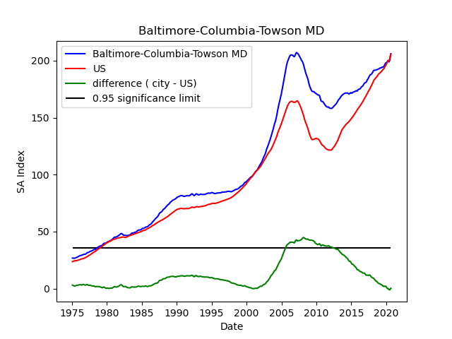
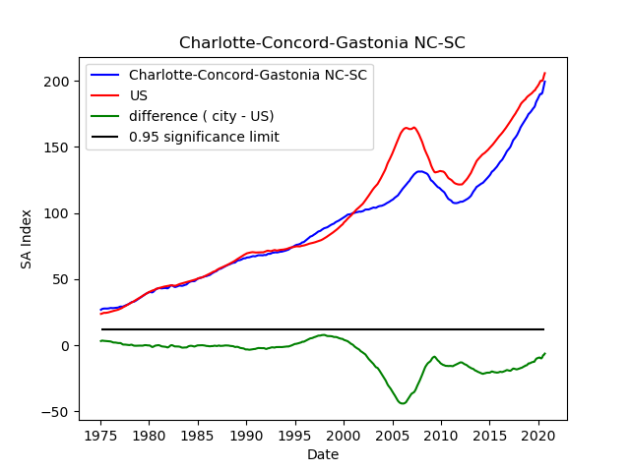




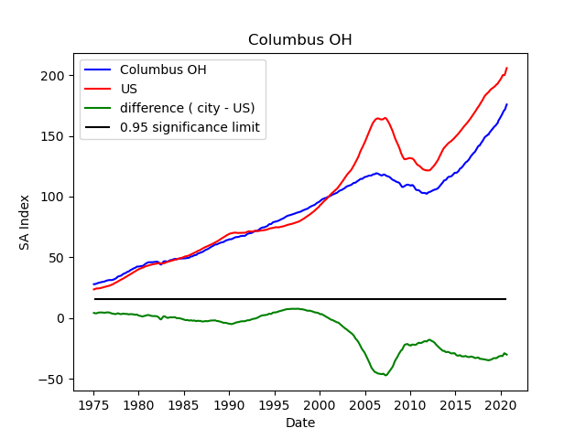
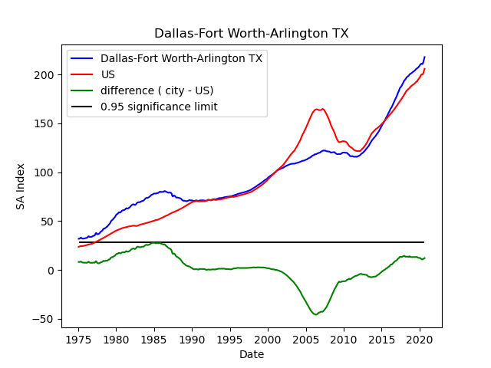



Slide 7
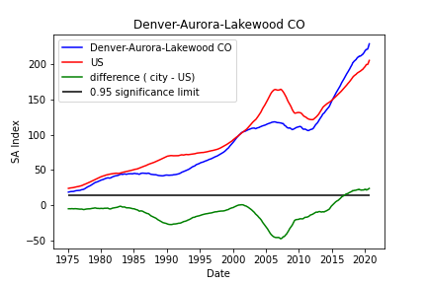
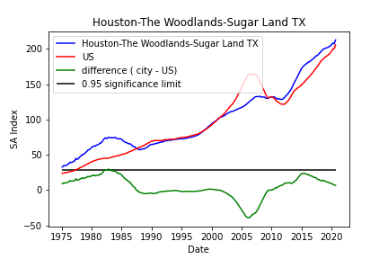


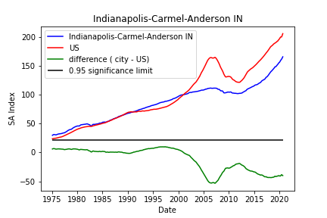
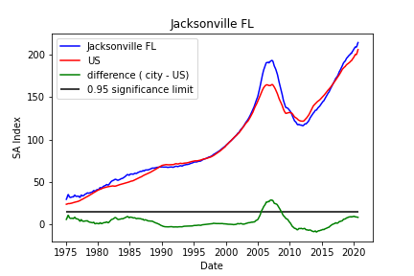



Slide 8
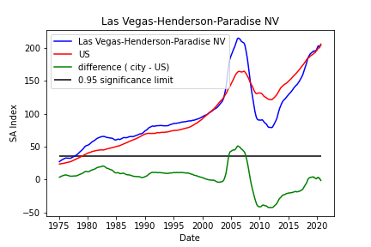
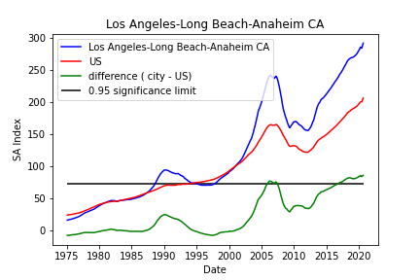




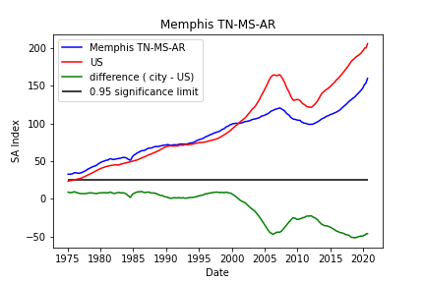
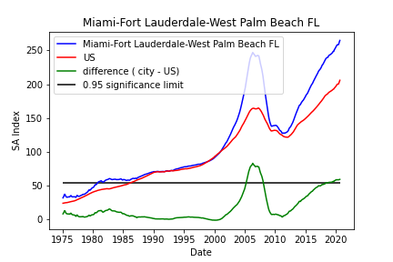



Slide 9
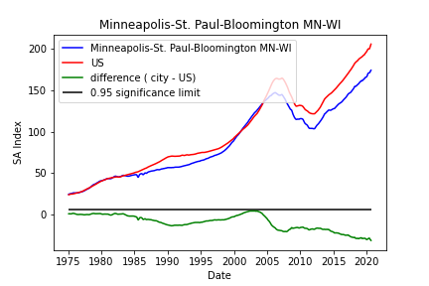
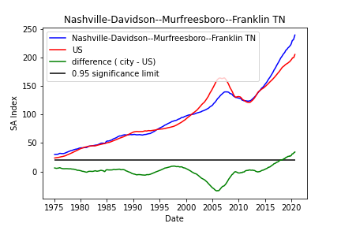



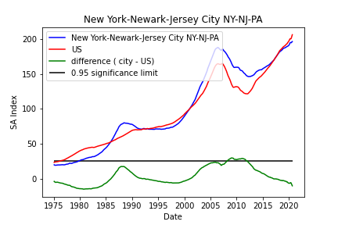
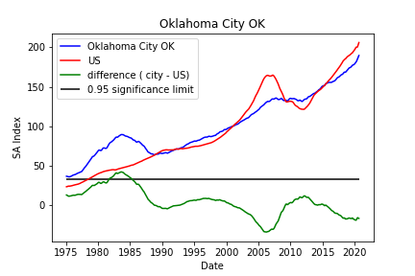



Slide 10
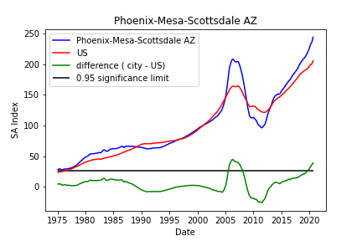
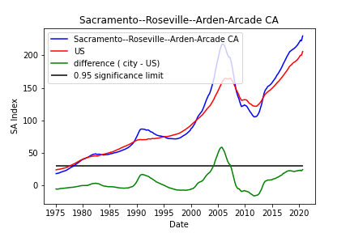



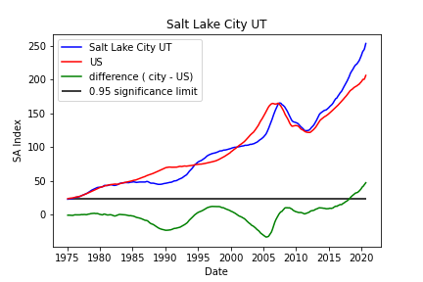
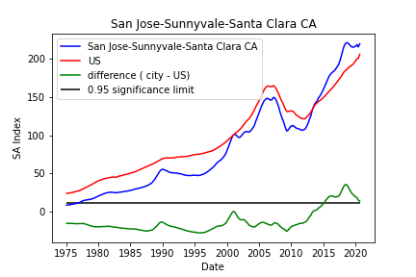



Slide 11
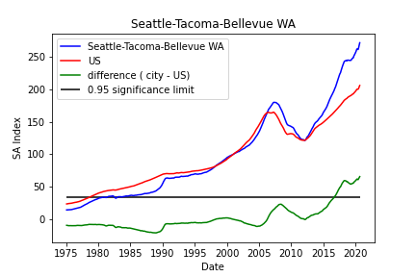
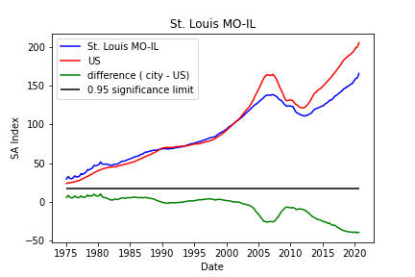

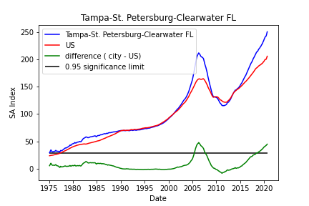
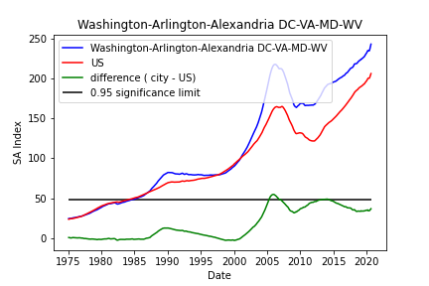






Slide 12
Findings & Conclusions
Out of all the cities we reviewed:
The city/metropolitan area of Washington DC we found that there was statistical evidence suggesting that when the Nationals MLB team moved to the city; something caused home values to rise.
The city/metropolitan area of Los Angeles we found that there was statistical evidence suggesting that around the time that the NFL Teams, Rams and Chargers; something caused home values to rise. We believe that California is booming due to other reasons.
The remaining cities showed no statistical evidence that when a professional sports team moved to the city, home values for the city rose to a statistically significant level.

Slide 13
Limitations & Other Considerations
We looked at the home value of the city as a whole. If we were going to continue our research we would have liked to look at the home valuation data of the houses in a 2 mile radius surrounding the sport’s team stadium.
If we had access to additional funding, we could have used a different API to carry out this research with more parameters.
For further research we would also like to take a look at how many businesses were created in the years following a professional sports team moving to the respective city.
For further research: Does the real estate value of homes drop when a professional sports franchise leaves city, the inverse of our analysis?
We did not research whether or not a large business/factory moved to the respective city. Big business moving into the city most likely contributed to home value growth.
For further research: how does the valuation of the franchise at the time of the move impact the swing in housing prices? Do higher valued franchises cause a larger change in housing prices

